Slide 1
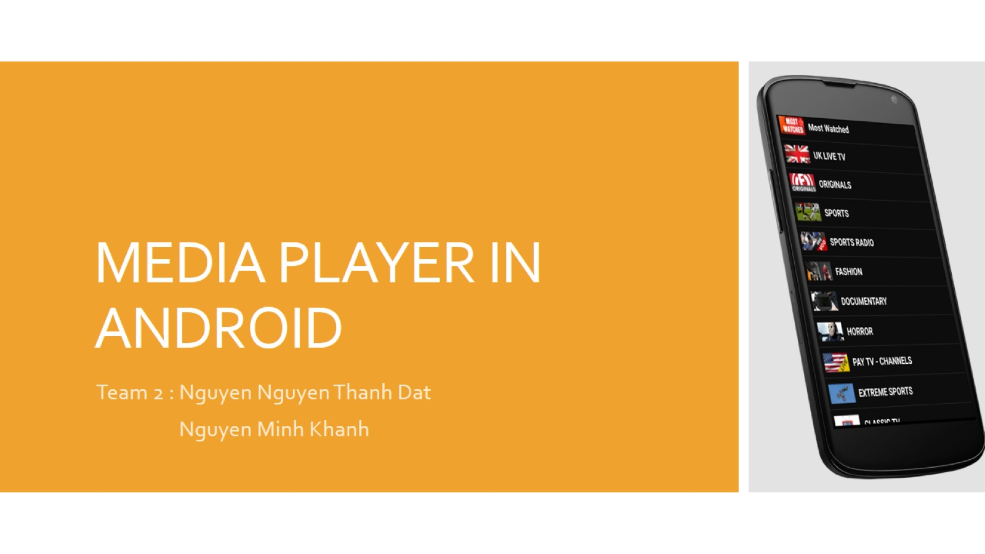
MEDIA PLAYER IN ANDROID

Slide 2


Introduction

Slide 3
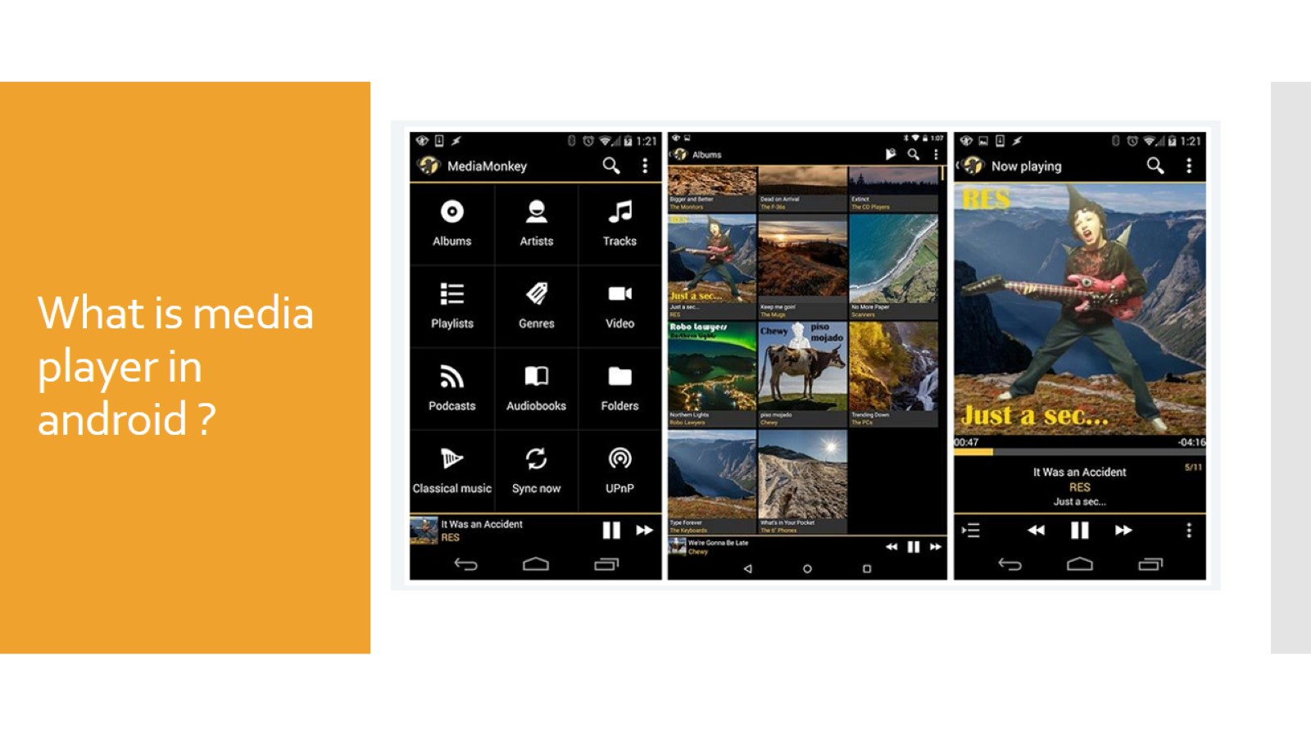
What is media player in android ?

Slide 4
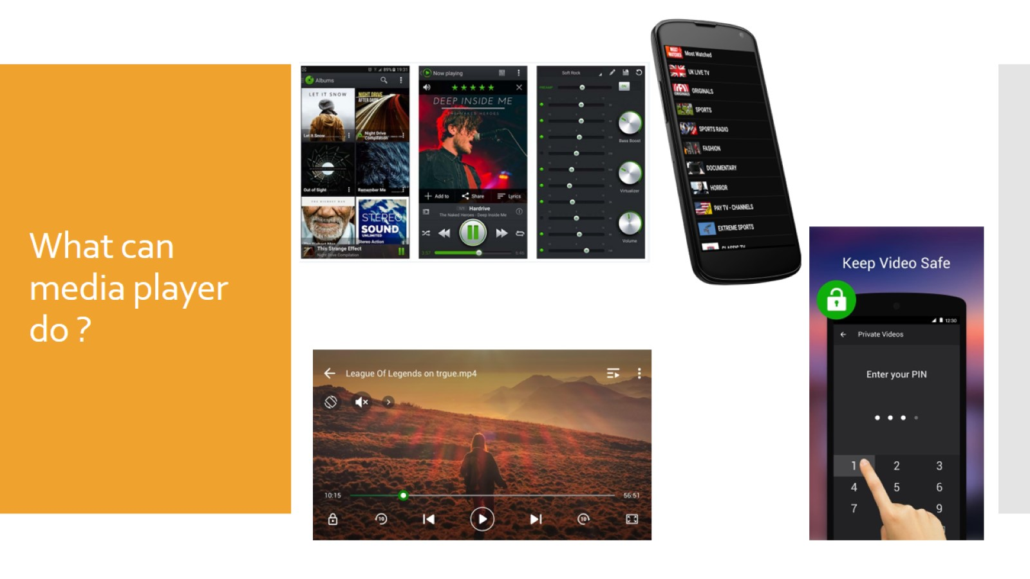
What can media player do ?

Slide 5
What can media player do ?

Slide 6

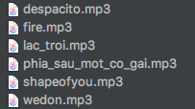
How to build media player application in android ? (Step one)

Slide 7

Design Screen with code (Next step)

Slide 8
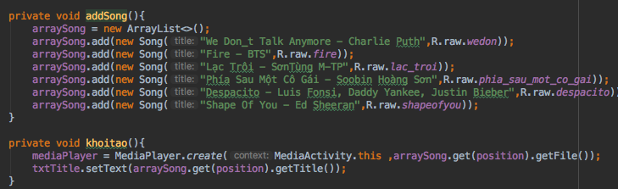
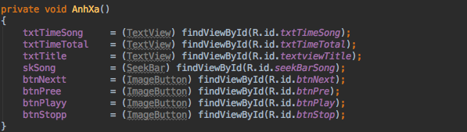
Code – behind (Next – Step)

Slide 9
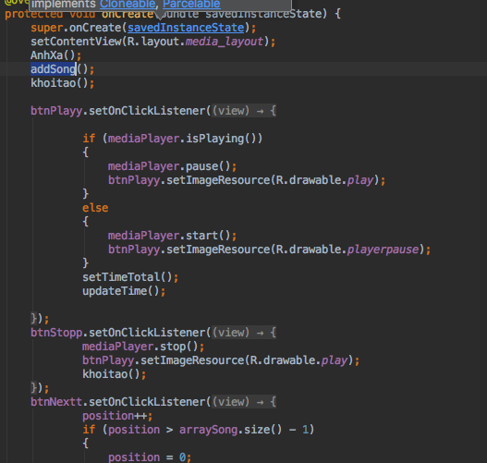
Event (Next – Step)

Slide 10
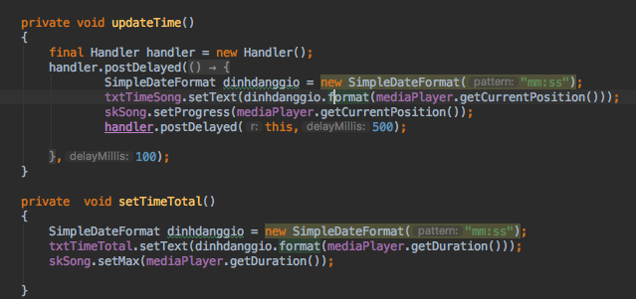
Final Step

Slide 11
Tài Liệu Tham Khảo :
https://www.youtube.com/watch?v=1lSkr9anY6E

Slide 12
For Example
PLEASE WAITING SOME SECOND FOR SETUP !!!

Slide 13
The – enD !
THANK FOR YOUR ATTENTION !!

